Slide 1
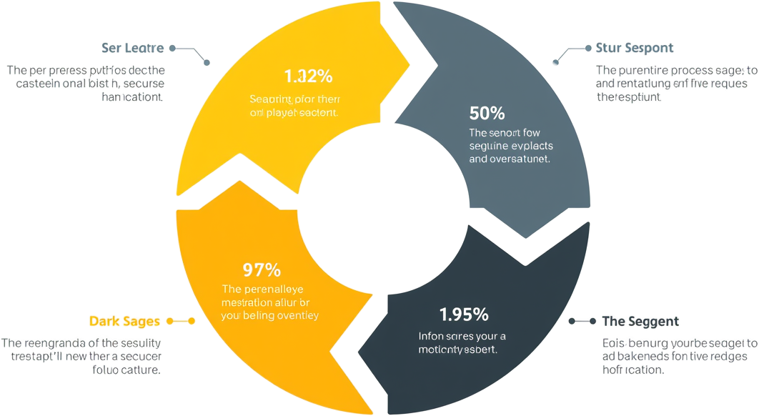
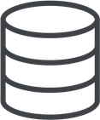



Data Center Storage Training Overview
A comprehensive guide to understanding how storage works, hardware components, protocols, and emerging technologies in modern data centers.
Storage Fundamentals
Protocols & Architecture
Understanding core storage concepts, data types, and centralized management principles.
DAS, NAS, SAN architectures and protocols like NVMe, FC, iSCSI.
Hardware & Cabling
Emerging Technologies
Physical components from drives to facilities, including wiring infrastructure.
Cloud storage, virtualization, all-flash arrays, and next-gen solutions.

Slide 2




What Is Data Center Storage?
A centralized environment for storing, managing, and distributing five key categories of digital information.
Web Content
Websites, media files, and streaming content delivery.
Email & Communications
Corporate messaging, collaboration tools, and archives.
Business Data
Financial records, CRM systems, and enterprise databases.
Application & Big Data
User applications, AI datasets, and analytics workloads.

Slide 3
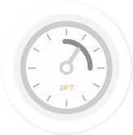



Why Storage Is Important
Understanding the critical factors that make data center storage essential for modern enterprises.
Accessibility
Security
24/7 data retrieval for critical business services and operations.
Encryption, firewalls, and physical controls protect data.
Scalability
Cost Efficiency
Expand storage capacity without rebuilding infrastructure.
Deduplication and compression reduce operational expenses.

Slide 4

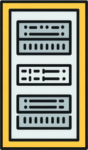
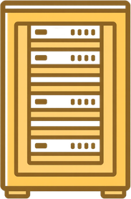
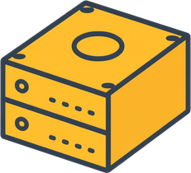
Hardware Components & Physical Layout
Understanding the hierarchical structure from individual drives to complete data center facilities.
Drive & Tray Level
Individual drives (1-30 TB) housed in trays for organized deployment.
Rack & Row Level
Multiple trays form racks (1 PB+), arranged in rows for efficiency.
Data Hall Level
Rows combine into data halls supporting 1-100 PB capacity.
Facility Level
Complete facilities house multiple halls achieving multi-petabyte scale.

Slide 5
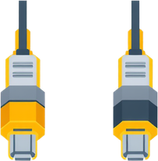


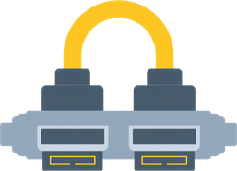
Wiring & Cabling Infrastructure
Understanding cable types and routing paths for optimal data center connectivity.
Ethernet Cat6/6A
PCIe & Twinax DAC
Network connectivity through raised floor trays for LAN infrastructure.
Direct attach cables for short-range high-bandwidth links.
Fibre Channel
SATA/SAS
High-speed SAN connectivity via overhead trays for enterprise storage.
Internal drive connections within rack enclosures.

Slide 6




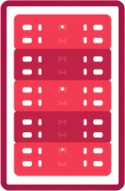



Storage Architectures
Understanding the four primary storage architecture approaches for modern data centers.
NAS
Hybrid
Network-Attached Storage enabling multi-user file sharing.
Combines on-premise and cloud for flexible scalability.
DAS
SAN
Direct-Attached Storage with fastest latency and simple connectivity.
Dedicated high-speed network for enterprise-grade performance.

Slide 7
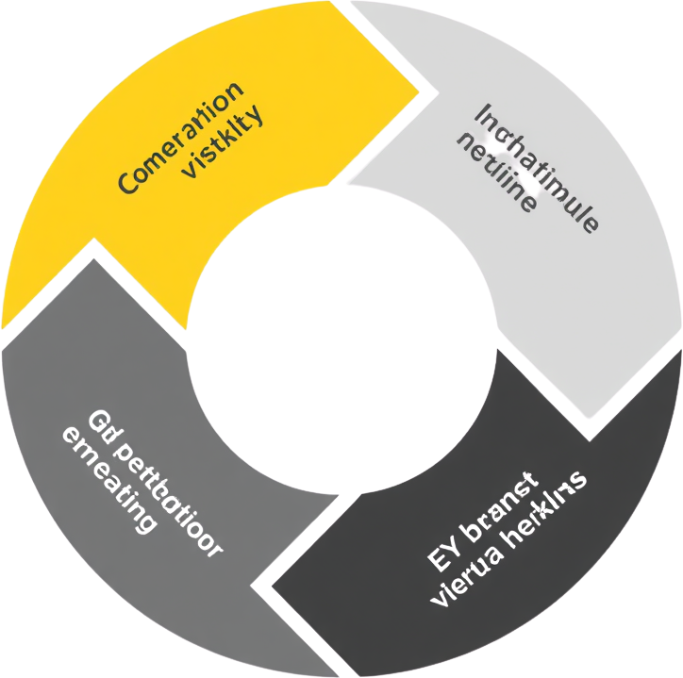
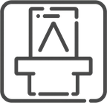


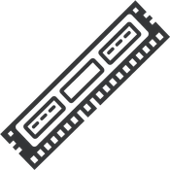
DAS Architecture Flow
Direct-Attached Storage provides the fastest latency with direct cable connections between server and storage drives.
Application Request
RAID Controller
Application initiates file access request to retrieve or store data from local storage.
RAID controller identifies target drive and manages data striping or mirroring.
OS Block Command
Data to RAM
Operating system translates request into block-level SCSI/SATA commands.
Retrieved data is sent directly to server RAM for application processing.

Slide 8
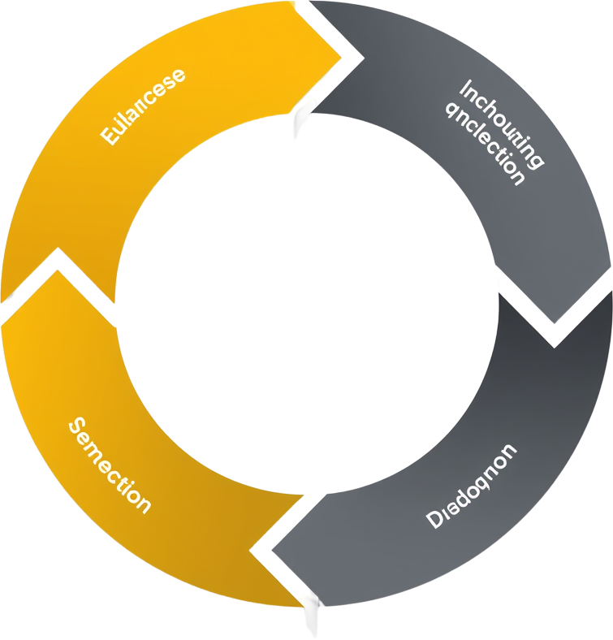




NAS Architecture Flow
Network-Attached Storage enables multi-user file access over Ethernet, providing shared storage with moderate speed and excellent accessibility.
User Request
NAS OS Locates
User or application initiates a file request through the network interface.
NAS operating system processes the request and locates the requested file.
Ethernet Switch
File Returned
Request travels via Ethernet switch to the NAS device over the local network.
Data is returned over the network to the requesting user or application.

Slide 9
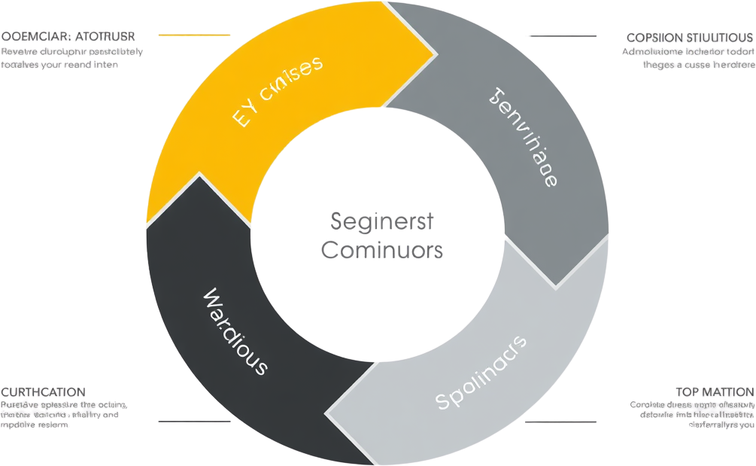
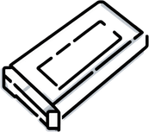

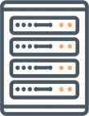

SAN Architecture Process Flow
Storage Area Network (SAN) delivers high-performance, enterprise-grade storage through dedicated Fibre Channel networks for mission-critical applications.
HBA Command
Array Processing
Server Host Bus Adapter (HBA) initiates SCSI command to request data blocks.
Storage array controller locates requested data blocks and prepares retrieval.
FC Switch Routing
FC Frame Return
Fibre Channel switch receives request and routes to appropriate storage array port.
Data returned via FC frames through switch back to server HBA.

Slide 10

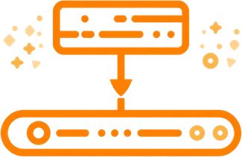
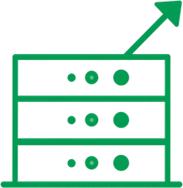
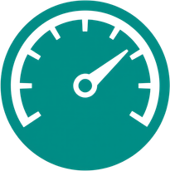
DAS vs NAS vs SAN Comparison
Understanding key differences in connectivity, protocols, performance, and scalability.
Connectivity
Performance
DAS: Direct cable to server. NAS: Ethernet network. SAN: Dedicated FC network.
DAS: Lowest latency. NAS: Moderate speed. SAN: High throughput for enterprise.
Protocols Used
Scalability
DAS: SATA/SAS. NAS: NFS/SMB over TCP/IP. SAN: Fibre Channel/iSCSI.
DAS: Limited to server. NAS: Easy expansion. SAN: Enterprise-grade scaling.

Slide 11




Data Flow — End-to-End Process
Understanding how data moves from user action to storage confirmation.
User Saves Data
OS breaks data into blocks for processing.
Data Encoding
Controller encodes blocks for transmission.
Network Transmission
Data transmitted via cable or network switch.
Storage Write & ACK
Storage array writes data and returns ACK confirmation.

Slide 12
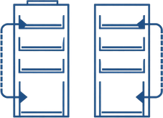
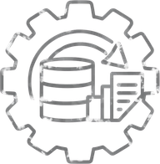


RAID Overview
Redundant Array of Independent Disks — balancing performance, capacity, and fault tolerance.
RAID 0/1 — Speed & Mirror
RAID 10 — Hybrid Performance
RAID 0 stripes data for maximum speed. RAID 1 mirrors for full redundancy.
Combines mirroring and striping for high performance and redundancy.
RAID 5/6 — Parity Protection
Use Cases & Selection
Distributed parity enables fault tolerance with efficient storage utilization.
Match RAID level to workload: databases, archival, OS drives, or NAS arrays.

Slide 13
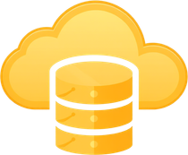



Virtualization & Cloud Storage
Modern storage solutions combining virtualization, cloud infrastructure, and content delivery.
Storage Virtualization
CDN Integration
Combines multiple arrays into one logical pool.
Content delivery networks for faster global access.
Cloud Storage
CSP Integration
Data accessed via HTTPS/REST API from cloud providers.
AWS, Azure, GCP connectivity and management.

Slide 14



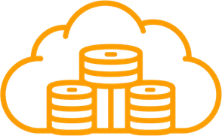
Next-Generation Storage Technologies
Emerging innovations driving the future of data center storage infrastructure.
All-Flash Arrays
100% SSD-based storage delivering ultra-low latency and high IOPS.
NVMe-over-Fabrics
Extending NVMe protocol across network fabrics for faster access.
Software-Defined Storage
Decoupling storage software from hardware for flexible management.
HAMR & Object Storage
Heat-assisted recording and scalable object storage for massive datasets.

Slide 15




Market & Cost Insights
Understanding data growth trends, market revenue, and storage cost dynamics.
Global Data Growth
Projected to reach 291 ZB by 2027, up from 20 ZB in 2016.
Market Revenue
Cost Per GB Trends
Storage market growing from $48B to $62.6B by 2028.
HDD: $0.01-$0.10, SSD: $0.04-$0.20, Tape: $0.002-$0.01.
Industry Leaders
AWS, Azure, Dell EMC, NetApp, Pure Storage, Seagate.

Slide 16

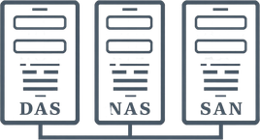
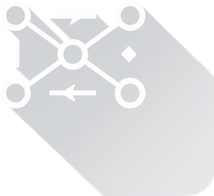
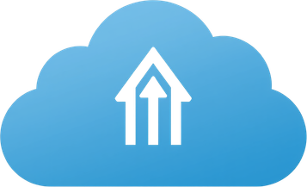
Summary & Key Takeaways
Essential concepts from Data Center Storage training to remember and apply.
Storage Hierarchy
Architecture Models
Drive → Tray → Rack → Row → Data Hall → Facility scaling.
DAS for speed, NAS for sharing, SAN for enterprise.
Key Protocols
Future Technologies
NVMe, Fibre Channel, iSCSI, NFS/SMB for data transfer.
All-Flash, NVMe-oF, SDS, HCI, and cloud integration.

